Slide 1
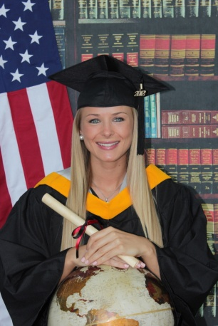
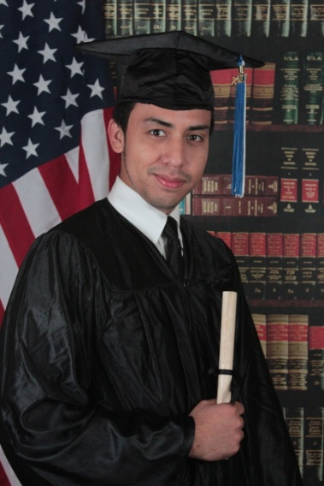
ATTENTION BARRY UNIVERSITY
GRADUATES!
THERE WILL BE A PROFESSIONAL
PHOTOGRAPHER AVAILABLE
PACKAGE A (ONE POSE $35)
ONE 8x10
TWO 5 X 7 CASH ONLY
EIGHT WALLETS
PACKAGE B (ONE POSE $65)
ONE 11 X 14
TWO 8 X 10 CASH ONLY
TWO 5 X 7
EIGHT WALLETS
PACKAGE C (TWO POSES $99)
TWO 11 X 14
TWO 8 X 10 CASH ONLY
FOUR 5 X 7
16 WALLETS + 1 CD with all your proofs
DATE: DEC 9, 10 AND 11, 2015 AT LANDON STUDENT UNION FROM 10 TO 6 PM
DEC . 12 GRADUATION AT THE JAMES L. KNIGHT CENTER
Call if you have any questions
DO IT
FOR
MOM
MEMORIES FOR LIFE
MAGGIE MARTZ 954-549-0901
E-MAIL: MARIELY0513@AOL.COM
NOTICE:
Cap and gown will be provided for the photo shoot. For best results we recommended v-neck collared blouse for the ladies. Shirt and tie for the gentlemen. You can view your proofs instantly. Why not capture this fantastic achievement forever with cap and gown portraits that you can display with pride and also give to your loved ones in appreciation for their support and understanding.

