Slide 1
to the 2013 Barry University CFP® Certification Professional Education Program www.barry.edu/ce
SCHOOL OF ADULT AND CONTINUING EDUCATION
Institute for Training and Professional Development
Welcome

Slide 2
SCHOOL OF ADULT AND CONTINUING EDUCATION
Institute for Training and Professional Development
The Program
CFP Board Approved and registered program
Six core modules plus Capstone
Weekend format for working professionals
3 Friday’s (5:30-9:30pm)/Saturday’s (8am-5pm) per module: 38 hours
Exception: Capstone 45 hours
Designed to assist in preparation for the CFP® Certification Exam
No admission requirements or application fee
Recommended Bachelors Degree per CFP Board requirement

Slide 3
SCHOOL OF ADULT AND CONTINUING EDUCATION
Institute for Training and Professional Development
What Topics are Covered?
CCP 173 - General Principles of Financial Planning
CCP 174 - Insurance Planning
CCP 175 - Investment Planning
CCP 176- Income Tax Planning
CCP 177 - Retirement Planning
CCP 178 - Estate Planning
CCP 179 - Capstone

Slide 4
SCHOOL OF ADULT AND CONTINUING EDUCATION
Institute for Training and Professional Development
The Importance of the CFP®
Financial Planning ranked as one of the top rated jobs in America.
The CFP ® designation is a key differentiation.
Additional benefits at www.cfp.net/become/career.asp

Slide 5
SCHOOL OF ADULT AND CONTINUING EDUCATION
Institute for Training and Professional Development
Why Choose the Barry University CFP Program?
CFP Board Approved
Weekend format for the Working Professional
Prepares you to be eligible to take the CFP® Certification Examination
Featuring a combination of American College textbooks and Ken Zahn material with a certified trained instructor working in the financial industry
Registration fee includes textbooks and materials
Special fee discount options
Excellent networking opportunities
Free accessible parking

Slide 6
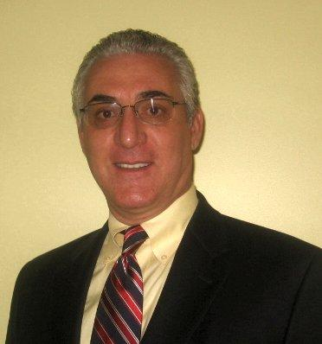
Ken Zahn Partnership and Associate Faculty
SCHOOL OF ADULT AND CONTINUING EDUCATION
Institute for Training and Professional Development
Glenn Downing, CFP®, Associate Faculty
Originally a Connecticut Yankee, Glenn J. Downing received his MBA from the University of Connecticut in 1984 with a finance concentration, and has been working in the financial services industry since moving to Florida in 1997. He attended Ken Zahn’s live review in November of 2005 and has been a CERTIFIED FINANCIAL PLANNER™ practitioner since 2006.
Glenn is associated with NL Financial Alliance in Coral Gables, an insurance company general agency. In addition to insurance licenses, he holds Series 6, 63, and 24.
In addition to his personal financial planning practice, Glenn has been an instructor of the CFP® curriculum since 2006.
He is an active member of the Financial Planning Association and a volunteer at the Miami Rescue Mission. In February of 2010 Glenn was honored by being invited to become a Board member of the Miami-Dade Citizens’ Independent Transportation Trust. This is the trust which was established by legislation in 2002 when Miami-Dade voters increased their sales tax by ½ penny to fund transportation infrastructure improvements, and oversees all disbursements from that revenue.

Slide 7
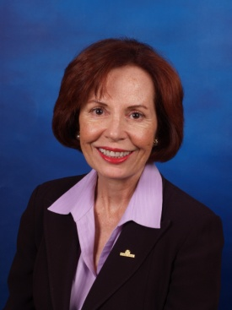
Ken Zahn Partnership and Associate Faculty
SCHOOL OF ADULT AND CONTINUING EDUCATION
Institute for Training and Professional Development
Patricia White Kearney, CFP®, Associate Faculty
Patricia has been working in the Financial Services industry since 2002 and has experience in Financial Planning, Client Portfolio Management, and Life, Disability and Long Term Care Insurance. She attended the Zahn Live Review in November 2009 with Ken Zahn and received her CFP Designation in 2010. She holds Series 7 and 66 securities licenses and a Life, Health and Variable Annuities Insurance License in Florida and Colorado.
Patricia formerly owned a Registered Investment Advisory firm serving high net worth clients. She has also worked for Northwestern Mutual as a Financial Representative providing asset and income protection to business owners and their families.
Patricia is an active member of Executive Women of the Palm Beaches and Leadership Palm Beach County. She has served as a board member in both organizations. Patricia is also a member of the Forum Club of the Palm Beaches and the Gold Coast Chapter of the Financial Planning Association.
Patricia is married and resides in Palm Beach Gardens, Florida. In her spare time, she enjoys ballroom dancing and traveling.

Slide 8
SCHOOL OF ADULT AND CONTINUING EDUCATION
Institute for Training and Professional Development
What is the Course Design?
Textbook (included in registration fee)
Ken Zahn Materials
Case Studies
Interactive
Quizzes and Examinations
Capstone

Slide 9
SCHOOL OF ADULT AND CONTINUING EDUCATION
Institute for Training and Professional Development
Registration and Special Discounts Available
Registration Fee: $890/course (Includes instruction, textbook and materials)
Option to register course by course or as a package.
Special Pricing Package Option: Enroll for all 7 courses and on a deferred payment plan and receive $280 in savings. For more information visit www.barry.edu/ce.
Locations: Miami Shores, Kendall and Palm Beach Gardens
For Assistance: contact Liisa Alvarez@ 305-899-3352or lalvarez@mail.barry.edu

Slide 10
SCHOOL OF ADULT AND CONTINUING EDUCATION
Institute for Training and Professional Development
Ask Questions Anytime!
Liisa Alvarez, Office Manager
Call 305-899-3352
Email lalvarez@mail.barry.edu

